Slide 1
Team 17
Sprint 4 Presentation

Slide 2
Presentation outline
Presentation will be around 15 minutes
15 minutes at the end for questions
Please feel free to stop me at anytime for clarification or other questions
Let me know if anything is hard to see over the screen share, we can always open up the relevant document to zoom in

Slide 3
Topics we will be covering
Current project backlog
Sprint 4 Summary + retrospective overview
Risk management plan
UI Prototype showcase
Architecture review + tech stack
Testing plan
Live demo
Sprint 5 planning
Questions?

Slide 4
Project Outline

Slide 5

Our Application

Slide 6
Current project backlog

Slide 7
Current project epics
Patient Management
Status Management
Contact Tracing
Appointments
Messaging System
Notification System
QR Code System
Authentication and Authorization
Project Setup
Project Infrastructure
Documentation
**View individual user stories from the backlog in the document submitted**

Slide 8
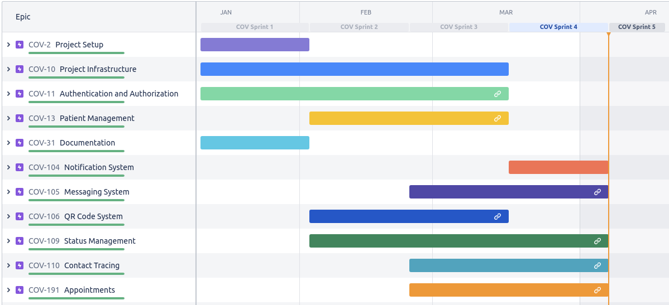
Progress in project

Slide 9
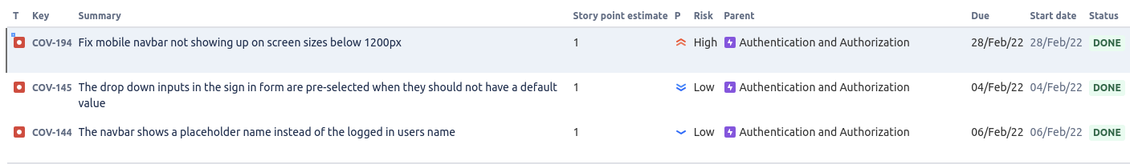
Defect tracking report
Total number of bugs: 3
Number of resolved bugs: 3
No new bugs found in Sprint 4

Slide 10
Sprint 4 Summary + retrospective overview

Slide 11
Our focus for sprint 4
Build out the contact tracing, chat, notifications, dashboards, and appointments flows
Refine some of the previous flows and use cases to reduce friction and the number of clicks it takes to do an action
Committed to 67 USP
Completed of 83 USP and closed all issues in the sprint

Slide 12
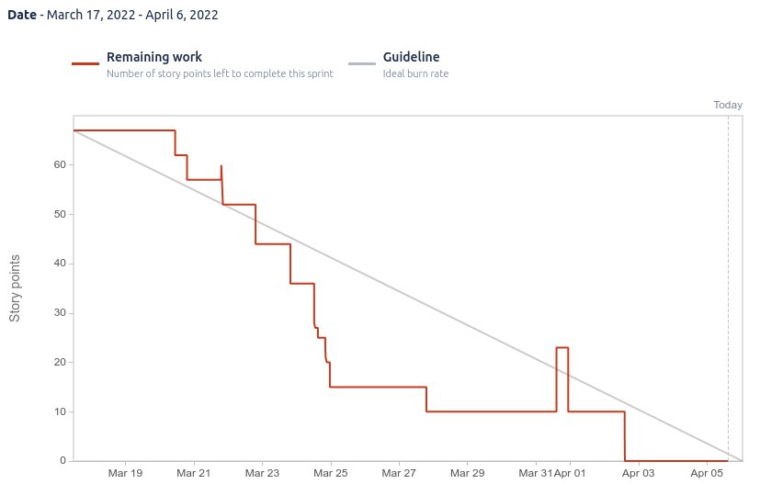
Burndown chart

Slide 13
Project velocity after sprint 4
Sprint 1 -> 56 USP
Sprint 2 -> 73 USP
Sprint 3 -> 76 USP
Sprint 4 -> 83 USP
Velocity = 72 USP

Slide 14
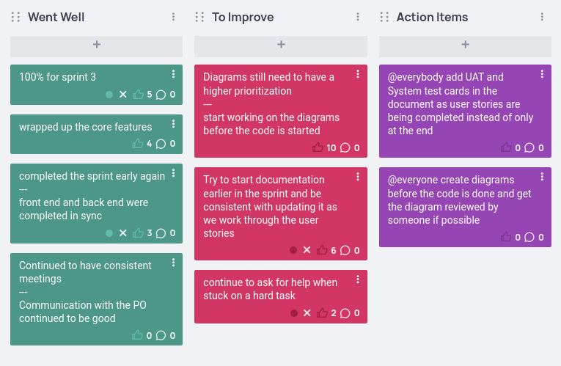
Our retrospective and action items

Slide 15
Risk management plan

Slide 16
Identified risks
We have identified 14 different risks for our project, all are documented in the submission.
2 new risks were identified in Sprint 4

Slide 17
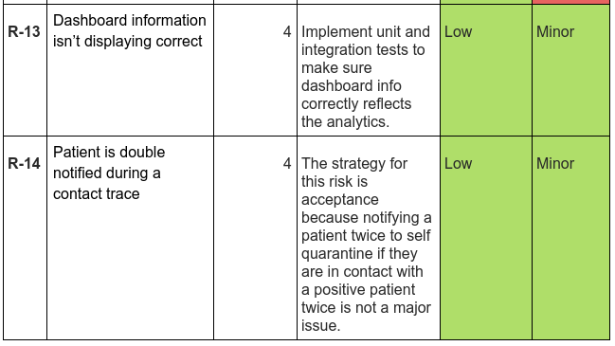
Risk(s) identified in sprint 4

Slide 18
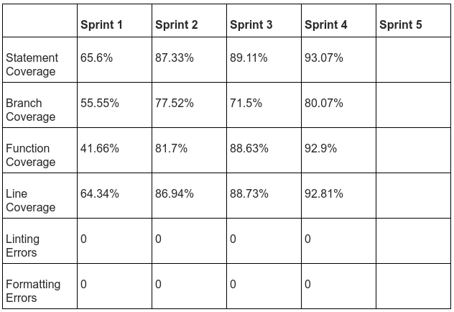
Update on quality metrics

Slide 19
UI Prototype showcase

Slide 20
Let's go into Figma and see the UI mockups and interactive prototypes

Slide 21
Architecture review + tech stack

Slide 22
Our systems viewpoints
The following 5 viewpoints have been identified to describe CovidTracker:
Context
Functional
Information
Development
Deployment
All the diagrams can be seen in the document, let me know if you want to reference any of them

Slide 23
Context Viewpoint
System Context Diagram
Use Case Diagrams
Split by user role

Slide 24
Functional Viewpoint
Component Diagram
Architecture Level Component Diagram

Slide 25
Information Viewpoint
Domain Model Diagram

Slide 26
Development Viewpoint
Sequence Diagrams
Activity Diagrams
This viewpoint is split by main development focuses (matches very closely with the structure of our projects epics)

Slide 27
Deployment Viewpoint
Deployment Diagram

Slide 28
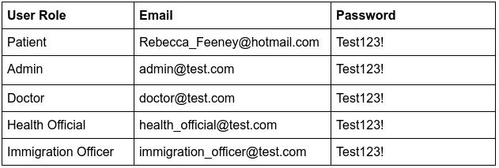
Deployment
Deployed on S3 + ECS
http://covid-tracker-client-bucket.s3-website.us-east-2.amazonaws.com/

Slide 29
Testing plan

Slide 30
Our testing plan
We have identified 4 types of tests for our system
Unit tests
Integration tests
System tests
Acceptance tests
Most are automated some are manual
Some have output reports
**More about the specific packages we use for our testing framework and a comparison between all of them can be found in the document**

Slide 31
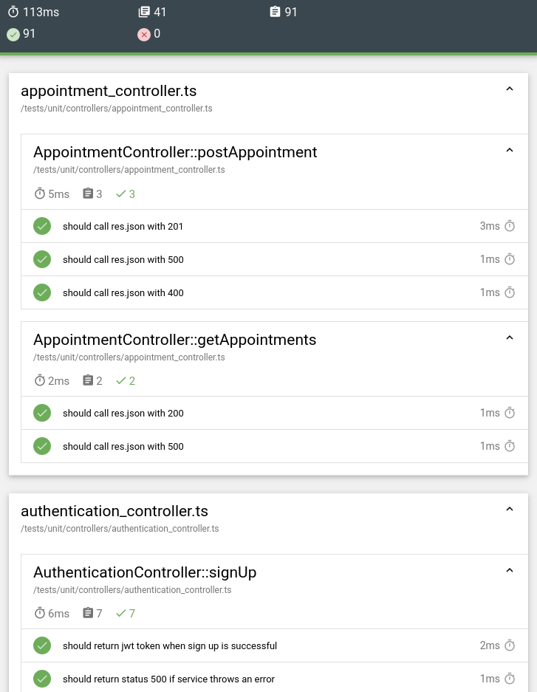
Unit test report
91 unit tests
57 integration tests
41 test suites
0 failures

Slide 32
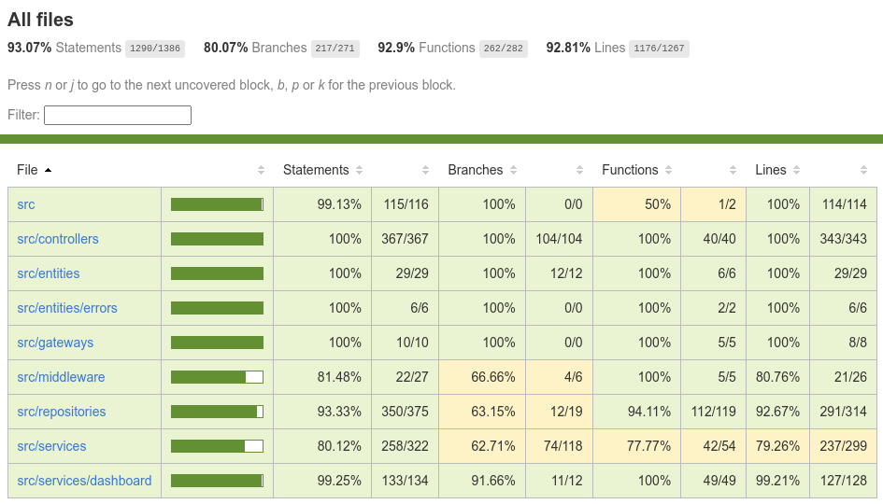
Code coverage report

Slide 33
Integration tests
Our integration tests are automated tests
The tests use a full PostgreSQL DB instance running in docker
We have written db initialization and seeding scripts to help scaffold the tests

Slide 34
System Tests
Run manually
Can be automated but not on our roadmap
Tests the systems functionalities end-to-end
Format is steps / action for the tester to perform and the associated outcome for each
System tests for each user story can be found in the submission document

Slide 35
Acceptance Tests
Run manually
Can be automated but not on our roadmap
Tests the system according to the requirements
For use this means they are derived directly from our user stories
Format is Gherkin Syntax which is a behavioral driven development (BDD) syntax that allows us to define our tests in terms of user state and behavior
Acceptance tests for each user story can be found in the submission document

Slide 36
Live demo

Slide 37
Sprint 5 planning

Slide 38
What’s next in Sprint 5?
We have finished all the user stories we committed to for the project and have nothing left unfinished in our backlog
Our focus will be on
Fixing any bugs we find
Refining any issues in the flows
Sprint 5 contains 0 story points

Slide 40
Questions?

